Slide 1
Sustainable Energy Corps
UEF Trustees – February 22, 2024

Slide 3
ILI Mission
Provide students and professionals lifelong career support
Provide companies with access to talent + tools to retain them

Slide 4
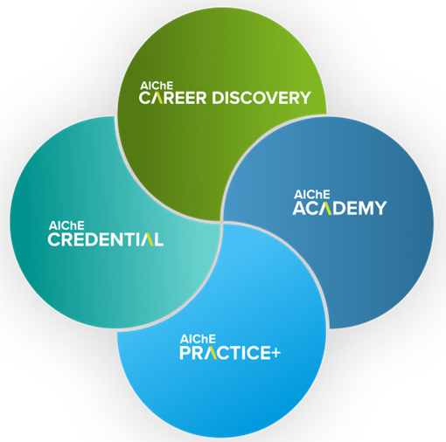
4 Pillars support learners at every career stage
Identify your next move
Validate your proficiency
Acquire skills
Apply your knowledge
(Sustainable Energy Corps lives here)
Industry engagement & support is key throughout

Slide 5
Sustainable Energy Corps
The What
Student teams from across the globe
Each team adopts a geographic region &
emission points of focus
Evaluate emission reduction options
Perform a techno-economic analysis to
recommend solutions
Write & present final report

Slide 6
Sustainable Energy Corps
The Why
Engages students in contributing to solving one of the world’s biggest challenges
Teaches the students valuable skills for
their future employers
Engages industry to participate &
provide feedback to the student teams

Slide 7
Sustainable Energy Corps
UEF Funding Supported Momentum!
Teams across the U.S. (4 regions – coast to coast!) & multiple other countries (Nepal, Nigeria, Mexico, …)
AIChE created training modules on non-fossil energy sources, existing mitigation technologies & GHG calculations
Building website of project team members & outputs
to enable global sharing (launching Winter ’24)

Slide 8
Sustainable Energy Corps
What’s Next?
Awarded DOE Community Energy Innovation Prize 1st round in partnership w/Lamar University
Pursuing 2nd round prize – winners announced March 2024
Exploring additional grant & sponsorship
opportunities

Slide 9
Sustainable Energy Corps
How Can You Help?
Sponsor costs of the program
Student team stipends ($10K per team)
AIChE staff program management ($15K per year)
Volunteer time as mentors to student teams
Contact sec@aiche.org

